Slide 1
MOST IMPLEMENTED MANAGEMENT SYSTEM STANDARD 2030?
A Sustainable Future

Slide 2
AGENDA - 30+30 minutes
Welcome and introduction by Kasper Mühlbach, Chief Consultant at Danish Standards
Behind the idea by Jacob Færgemand, Country Chief Executive Nordics, Bureau Veritas A/S
Justification study and our proposal – facts and figures by Kasper Mühlbach, Chief Consultant at Danish Standards
The process from this very minute by Mette J. Sandager, Standardization Consultant at Danish Standards
Q & A

Slide 3
Behind the idea
Jacob Færgemand

Slide 4
WHY
Increasing demand for verification of the approaches and results
Rapid development of private schemes
Strong focus on both SDGs and ESG reporting
Legislation towards ESG reporting is increasing (EU)
No tool available for organozations already using HLS based ISO management system standards
No tool available for SMEs to adress their need for systematic approach for working with the SDGs

Slide 5
Value
The wide range of ISO Management System Standards provide significant value and benefits the international community in different areas including quality, environment, health and safety, energy and many more.
However, these standards focus on an isolated part of contribution to the UN SDGs and do not give the organizations a framework for defining a sustainability strategy, purpose, and direction.

Slide 6
Potential benefits
a) Facilitating opportunities to enhance stakeholder satisfaction
b) Enhance the opportunity to become a preferred partner
c) Increase credibility enhancing the chance for getting eg. better external financing
d) Addressing risks and opportunities associated with its context and objectives
e) Avoid SDG-washing
f) Enhance confidence
g) Enhance the organization’sperformance
h) Fulfil complianceobligationi)Achieve selected SDG objectives
j) Increase success
k) Create trust and confidence to relevant existing and future stakeholders.

Slide 7
Purpose
The purpose of this standard is to provide one framework for all organizations to work actively and effectively with a selection of UN’s Sustainable Development Goals relevant to their business and thereby not all 17 but only the ones that are relevant for the context of the organization and its stakeholders enabling an organization to enhance its performance on sustainable development.

Slide 8
Justification study and our proposal – facts and figures
Kasper Mühlbach

Slide 9
Our Proposal
DS submitted a proposal for a SDG MSS which have been assessed by JTCG and and approved by TMB.
The aim is to create connection between organizational strategies and practices towards the SDGs and give organizations a business advantage while bringing the aim of the SDGs to practice.
The document will provide simple tools for how the individual organization can create processes to work with the SDGs adapted to the organization’s strategy.
The requirements will be generic and flexible so that each individual organization defines its scope, objectives, and possible improvements based on a high level of data integrity and valid data.

Slide 10
Background
No standard exists which addresses the SDGs as a whole and where the intention is to help organizations - large and small - to properly incorporate the SDGs into their business thinking, strategic objectives and embed them into the organization’s Key Performance Indicators and deliverables.

Slide 11
WHY ISO?
Well known for 9001, 14001 and 45001
High number of certifiable and accreddited standards
High confidence from various stakeholders
Standards based on consensus and best practices
Solid international reputation
Build upon HLS

Slide 12
Proposed Scope
This International Standard specifies requirements for a Sustainable Development Goals Management System when an organization:
1) Needs to demonstrate and enhance its work and performance towards the UN SDGs.
2) Seeks to manage its responsibilities in a systematic manner that contributes to pillars of sustainability.

Slide 13
Difference
The MSS aims to help organizations define select relevant SDGs, establish objectives, set the requirements, and achieve the intended outcomes of its SDG management system, which provides value for the society, the organization itself and interested parties. If deployed by a significant share of organizations already certified or complying to an existing MSS, it will have a huge impact on contribution to SDGs
While other MSSs provide confidence in an organization’s products, services, environmental issues, and compliance this MSS will provide a framework for organization’s ability to define and deliver according to a sustainable strategy based on the SDGs and thereby create the foundation for transparent and fact based non-financial SDG- and ESG-reporting.

Slide 14
Change in the agenda
Could we imagine a MSS taking over the position of 9001?
Could we imagine ISO playing a significant role in offering tomorrow’s standards to which organizations can be certified?

Slide 15
FACTS & FIGURES

Slide 16
SURVEYS
10.000 Surveys

Slide 17
GEOGRAPHY

Slide 18
RELEVANCE

Slide 19
INCREASING DEMANDS

Slide 20
ADVANTAGES

Slide 21
BEING INVOLVED

Slide 22
The ISO process
Mette Sandager

Slide 23
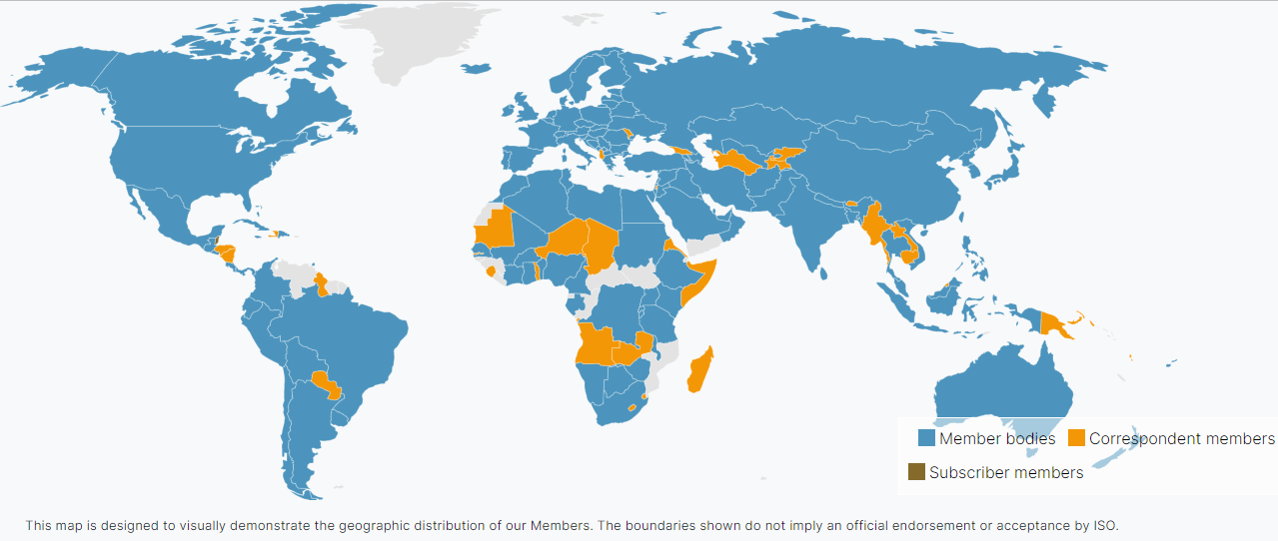
ISO members
All member countries can vote on the proposal

Slide 24
What is the vote ?
” Do you agree to establish a committee in ISO to discuss and develop a management
system standard for the UN SDGs?”
Please see Form 4 for further information on the proposal

Slide 25
How to vote?
Contact your ISO country member and let them know your position
The ISO member country will contact ISO and submit the national vote.
Deadline December 8th
https://www.iso.org/members.html

Slide 26
Whats next?
ISO establish a committee to discuss title, scope and content of the standard
No further work will be done in ISO for a MSS on SDGs

Slide 27
Plan
Early 2023: 1-2 meetings discussing Scope, Title and content
2023-2024: ISO consensus driven process for development of the MSS for the UN
SDGs (24m)
2024-2025: Approval and publication

Slide 28
How to participate?
Everybody are invited to participate in the work
Contact your ISO member Body (NSB)
Apply for Liaison status if your organization is:
Not for profit
Legal entity
Membership based
Relevant competence and expertise
Process for stakeholder engagement and consensus decision-making
You can apply for Liaison here

Slide 29
Q&A

